Slide 1

Intro to Python
Anshu Bantra
& Wade Coghlan
Please install Python from https://anaconda.com/download

Slide 2
What is Python?
Created by Guido Van Rossum in 1991.
High level programming language that can be used to automate administrative tasks or create large scale applications.
Simple, easy to use syntax that emphasizes readability.
Python is an interpreted language, meaning that it has an extremely quick change, test, debug cycle.
Zen of Python

Slide 3
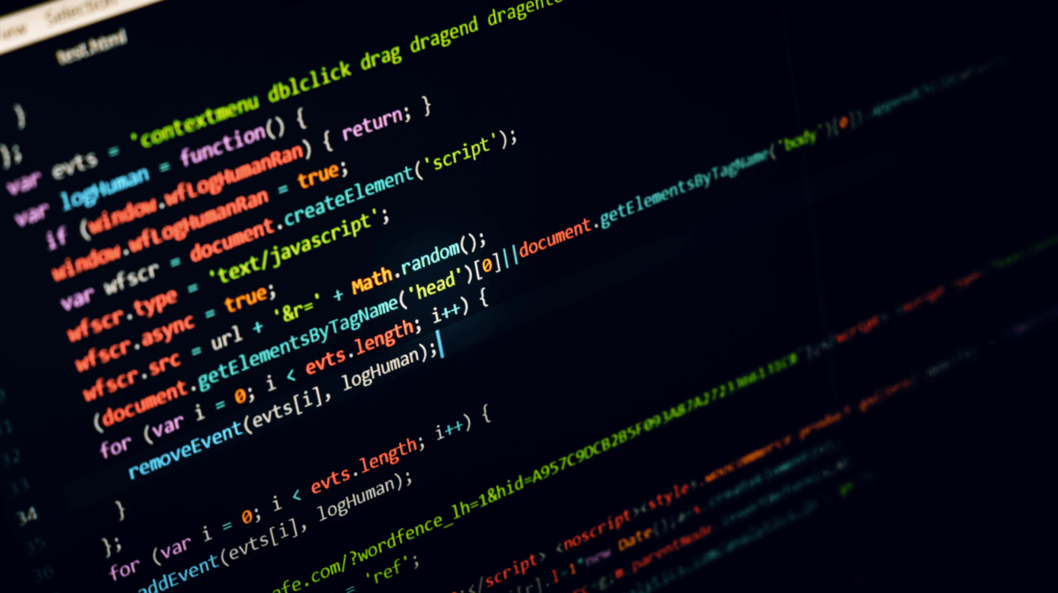
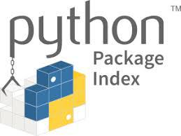



Why is Python so popular?
It has a large development community
It combines the best of multiple worlds from automating tasks, to building applications, to data science …
Access free software from the Python community with Pypi.org
It’s widely applicable
Build web apps
Build video games
Organize/plot data

Slide 4







Who uses Python?
4 | © 2018 General Assembly

Slide 5
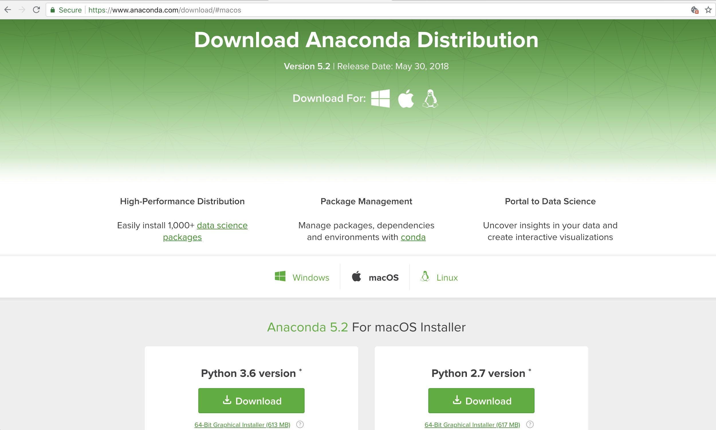
Download Anaconda https://anaconda.com/download

Slide 6
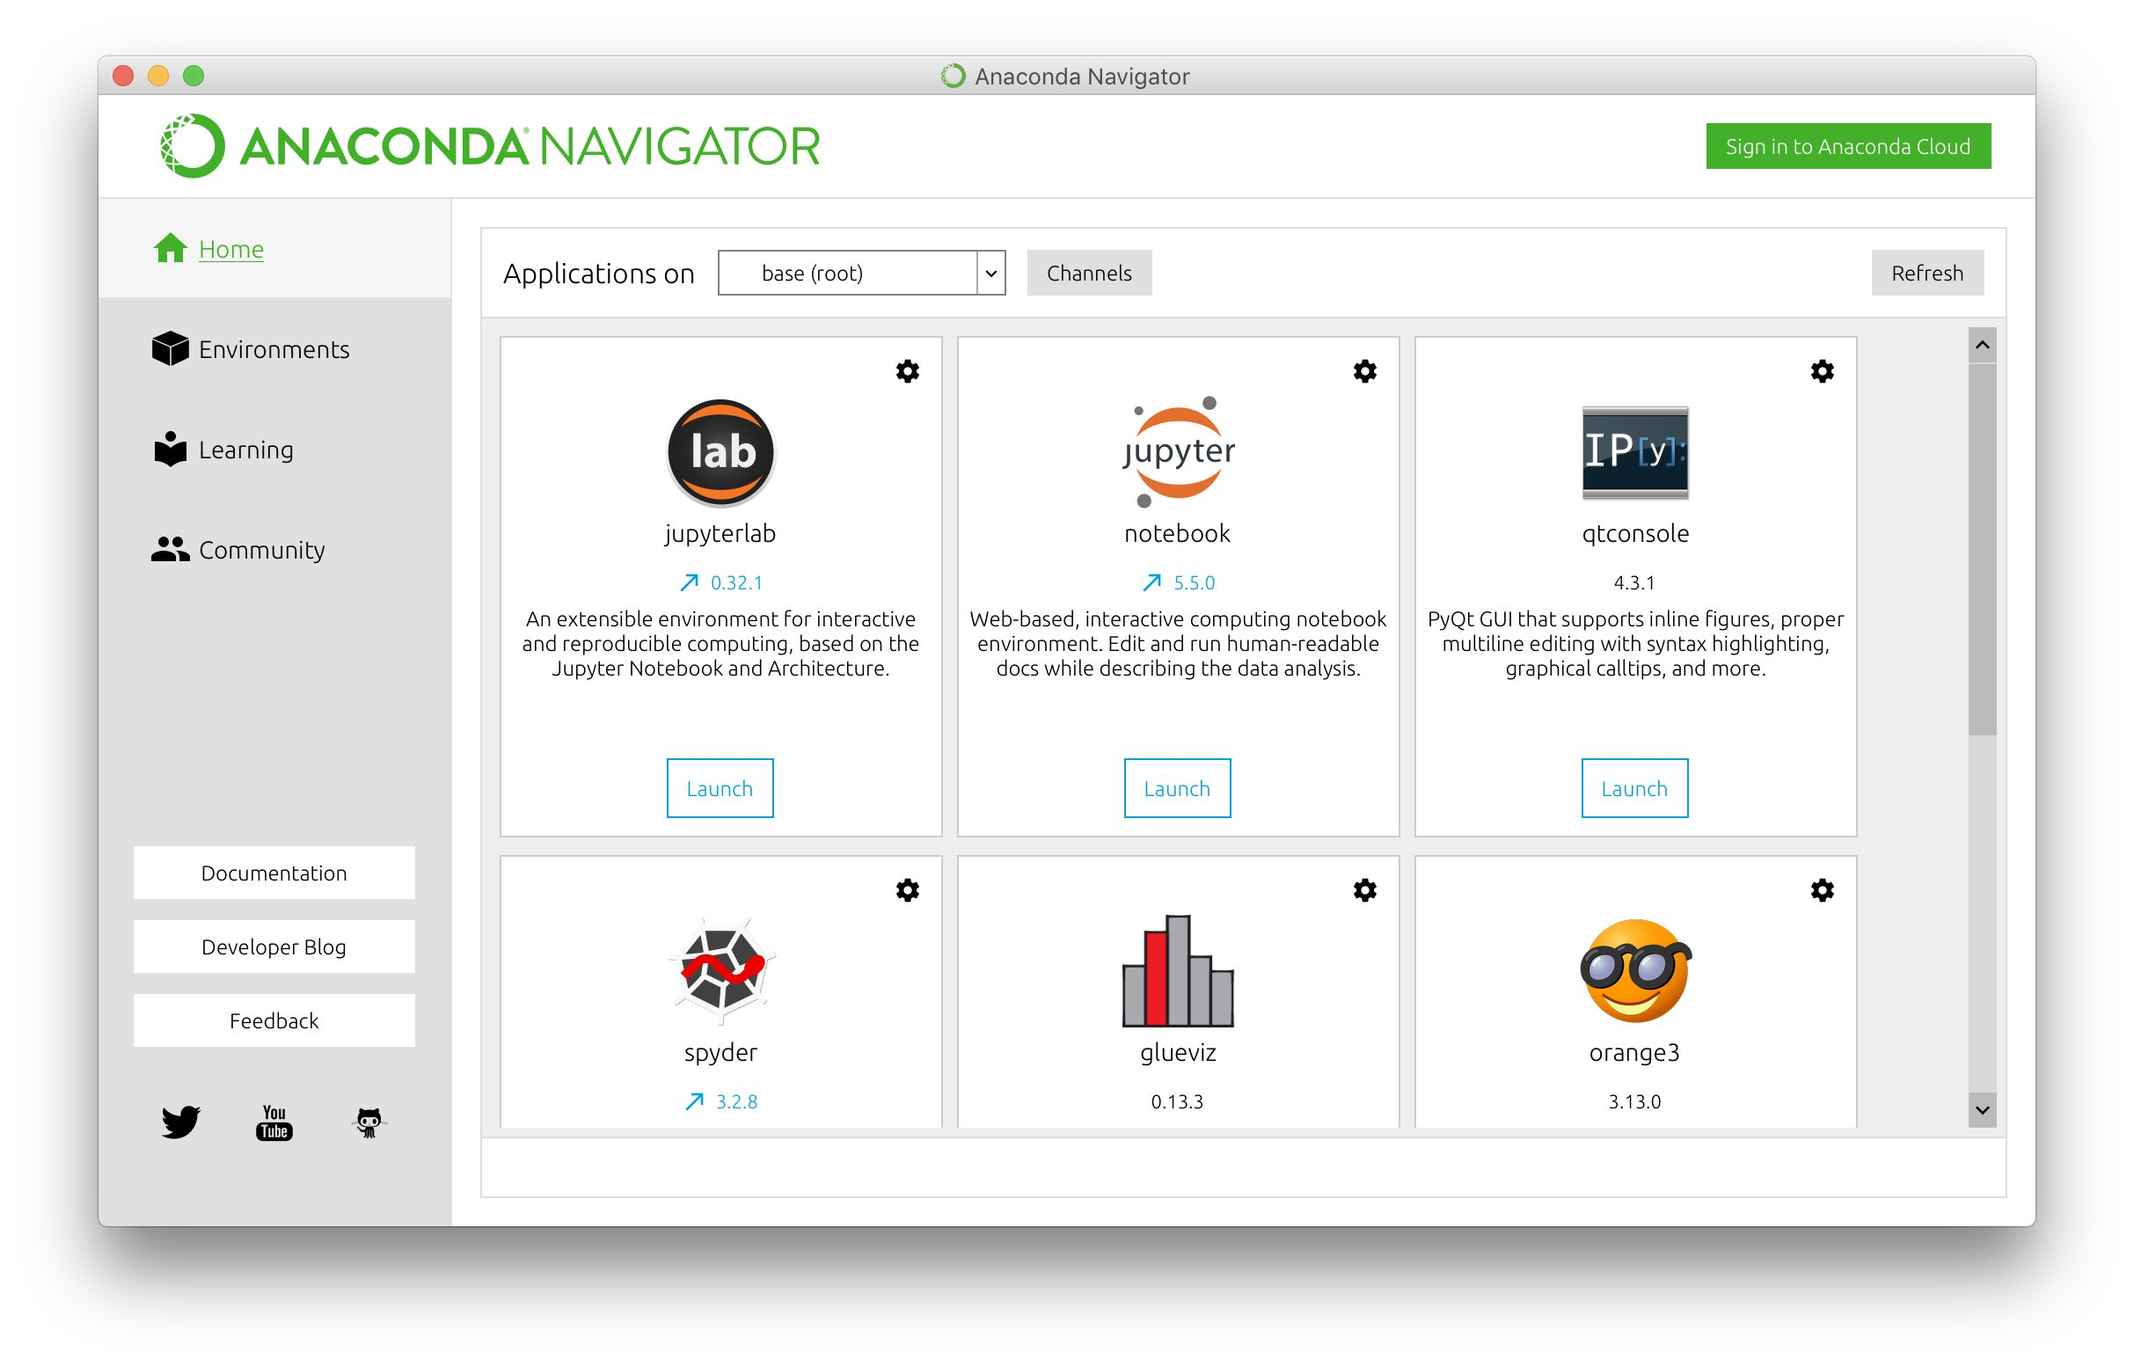
Anaconda Navigator

Slide 7
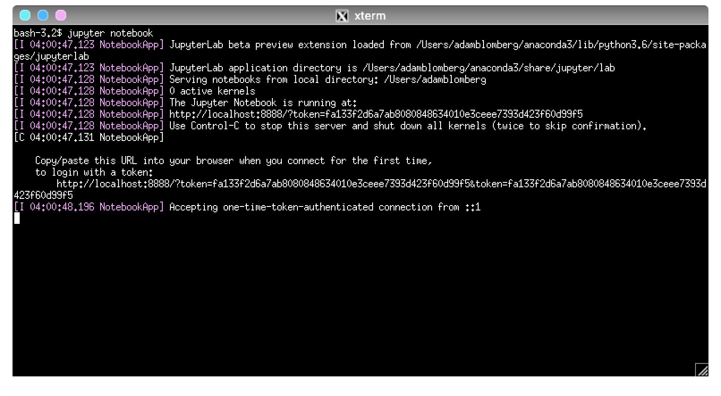
Terminal / Anaconda Prompt

Slide 8
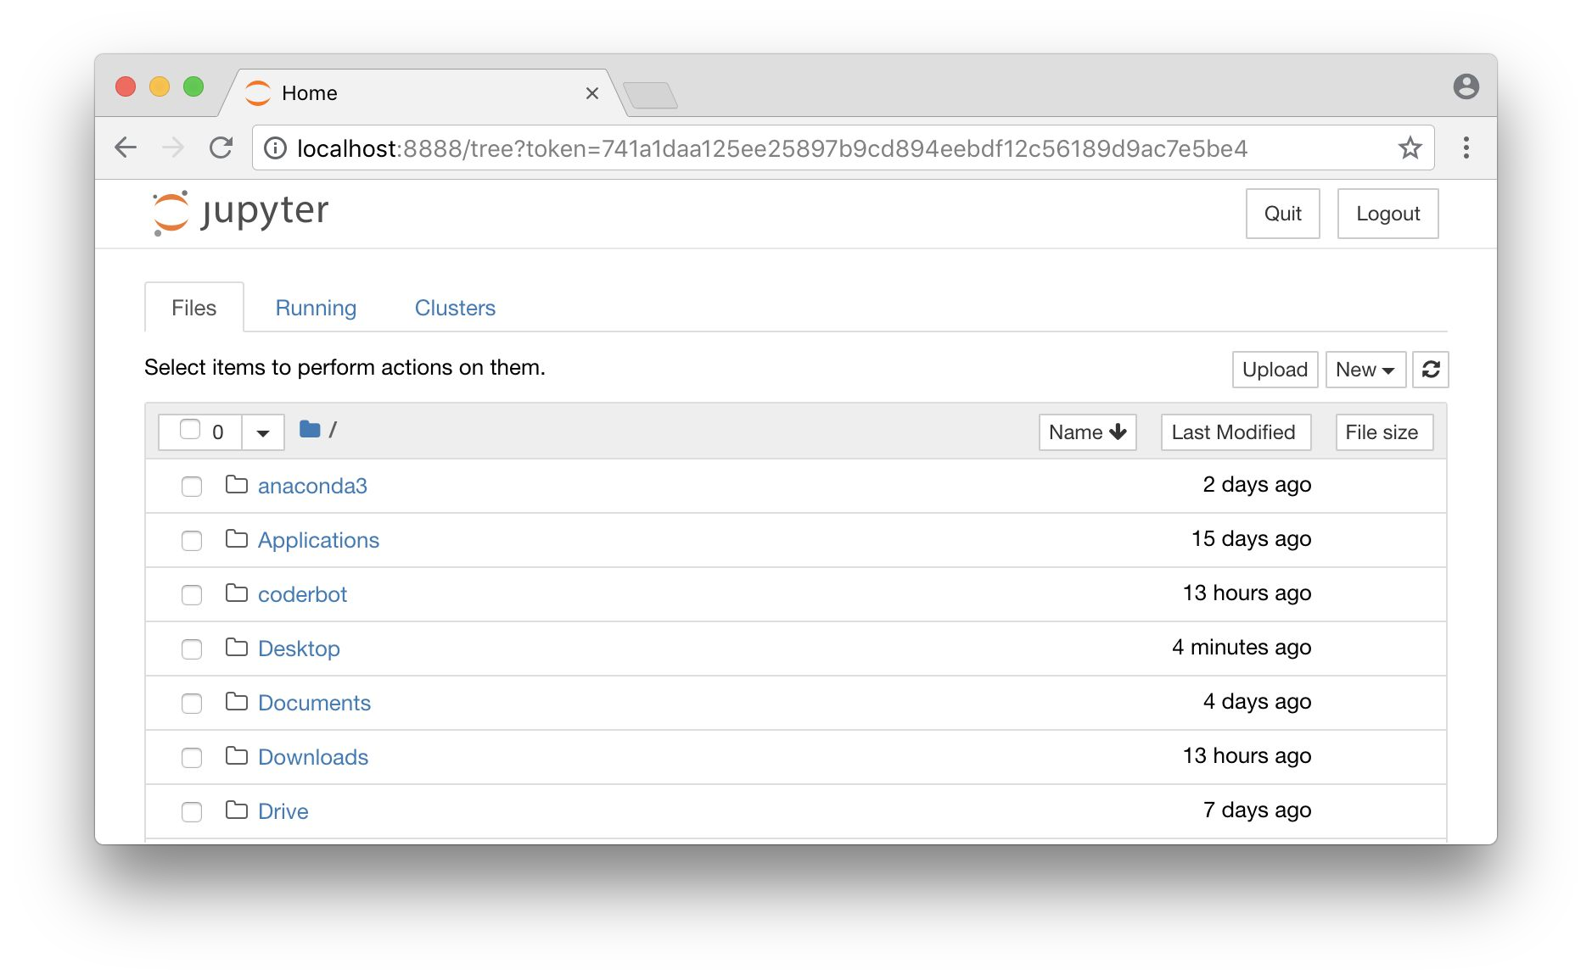
New Web Browser window with personal ﬁles

Slide 9
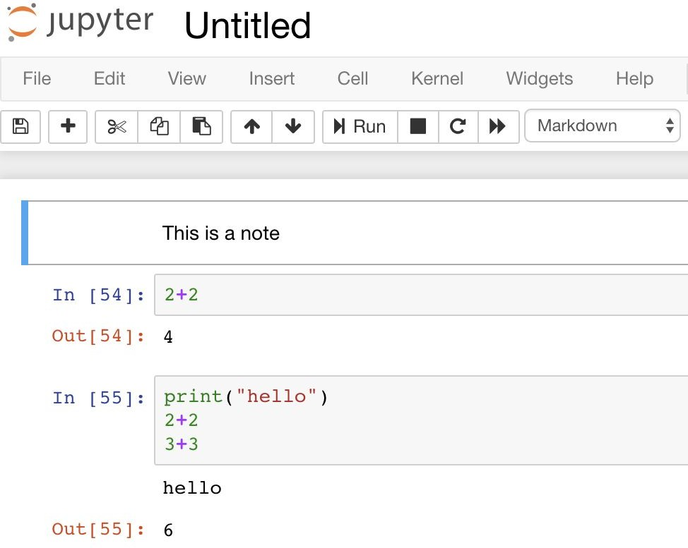
Jupyter Notebook
Cells:
Markdown for notes
Code for Python
Modes
Blue for commands
Green for editing
Execution
Ctrl + return
Shift + return
Output
Print (all)
Return values (last)

Slide 10
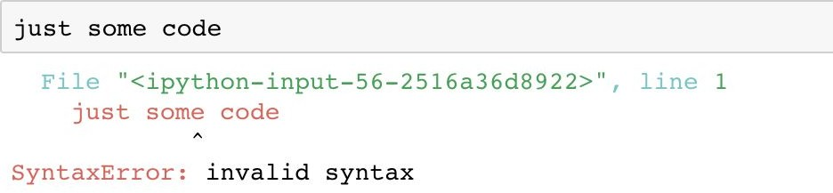
Jupyter Notebook errors
Mistakes happen! Here’s what they look like:
Try to understand what went wrong
Attempt to ﬁx the problem
Execute the cell again

Slide 11
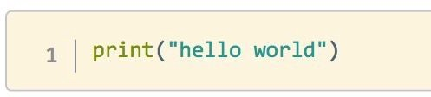
Python programming
Let’s see what a Python program looks like.
We’ll start with the classic "Hello World!" program:
This code will print the message "Hello World!" on the screen.

Slide 12
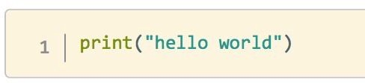
What did we just see?
Data
“hello world”
string
Denoted by quotation marks
Single ‘...‘
Double “...”
Triple “””...”””
Function
Print
Aside: # makes comments

Slide 13
Try out Jupyter notebook
Take some time to try out Jupyter notebook.
Make sure you can:
Convert cells between Markdown and Code
Edit and execute a note cell
Edit and execute a code cell
Try to do some math
Make an error

Slide 14
Programming Fundamentals
Every programming language can be broken down into core components. Having a general framework for this context will help us learn speciﬁcs for Python.
Syntax
The structure of the commands given to the computer
Variables
How computers store information
Control Structures
Sets the hierarchy/priorities of programming logic
Data Structures
How computers organize data

Slide 15
Syntax
The syntax of a programming language is the set of rules that deﬁne the combinations of symbols that are considered to be correctly structured programs in that language
Just like our spoken languages have structures like paragraphs and sentences, programming languages have code blocks and statements.

Slide 16
Variables
Variables are symbolic names that store a speciﬁc piece of information. Variables come in diﬀerent types in order to hold diﬀerent kinds of information.
For example: max_temp = 15
Deﬁnes a variable: named “max_temp”
This holds a numerical integer: 15
For example: temp_unit = “Deg. C”
Deﬁnes a variable: named “temp_unit”
This holds a non numerical value: Deg. C

Slide 17
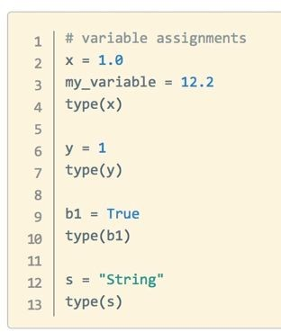
Variables
Types
Bool - 1 or 0, True or False
Int - number w/o decimal point
Float - number w/ decimal
String - text
Assignment
○ = operator deﬁnes variable
Variable names
snake_case
Lowercase Letters, Numbers, Underscores
type() function - shows data type

Slide 18
Variables
Operators - combine data
+, -, *, / (add, subtract, multiply, divide)
+=, -=, etc ( perform operation and save result)
** (power)
//, % (quotient, remainder (modulus))
>, <, ==, !=, <=, >= (greater than, less than, equal, not equal, etc)
Functions and methods - saved instructions to manipulate data
abs(my_int) - function_name(data)
len(my_string)
my_string.lower() - data.method_name()
my_int. add (5)
“Dunder” - double underscore (__) = important Python built in item

Slide 19
Practice in Jupyter notebook
Now you try!
Create variables
Bool
Int
Float
String
Check their class with type()
Try out some operations on your variables
What works? What causes errors?

Slide 20
Working with Variables
Let's work together and make some “Variable Magic”
Print a line saying your name, country of birth and where are you currently, as below: Hi I am Anshu, I was born in India. Currently I am based in Melbourne.
Create a cell which calculates the sum of 3 numbers
Check what happens if you use a “Variable”, that does not exist
What happens when we do math operations with strings (Non-Numbers / Alpha Numeric)
What happens when we do math operations between strings & numbers
Check data type of different type of variables.

Slide 21
Booleans
Booleans have only two values, i.e.: True or False.
Boolean algebra is the branch of algebra in which the values of the variables are the truth values true and false, usually denoted 1 and 0, respectively.
For example: 1 = 2
This results in a False
For example: age = 32; age > 25
Deﬁnes a variable: named age with value 32
This results in a True

Slide 22
Control Structures
A block of programming that analyses variables and chooses a direction in which to go based on given parameters is a control structure.
The term ﬂow control details the direction the program takes (how program logic “ﬂows”). It determines how a computer will respond when given certain conditions and parameters. Some typical structures include:
If statements
For loops
Functions

Slide 23
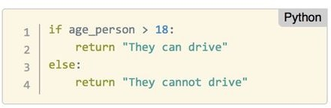
Control Structures
If / elif / else
Check conditions with boolean operators (i.e. <, >, ==)
Execute a single code block depending on result
If True: code runs
Can be:
if alone
if / else
if / elif(s) / else
Indentation controls end of if block
Data controls which code runs

Slide 24
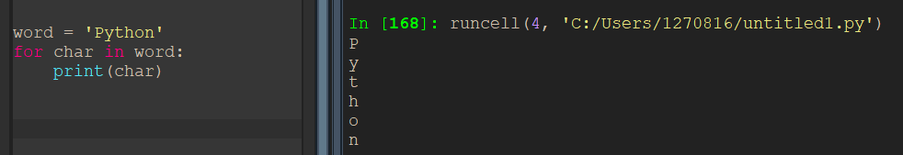
Control Structures
for loop
Repeat operations
Loop variable takes each value from list in turn
Indentation controls end of loop
Watch out for inﬁnite loops!
Interrupt or restart kernel when this happens

Slide 25
Working with Control Structures
Let's work together and make some “Decisions”
Write a conditional to read variable temp. If temp is greater than 25 then print, let’s go to the beach, if it is 25 or lower print Netflix it is.
Write a conditional to read variable temp. If temp is greater than 30 then print, let’s go to the beach, If temp is greater than 15 then print, let’s go for a walk, if it is 15 or lower print Netflix it is.
Get user input for number and print out if it is odd or even.
Assign value to two variables, check if they are numbers, if either is not print a message. If they are numbers print which is greater than the other, or if they are equal
Assign a string to variable and loop over the characters of the string

Slide 26
Data Structures
A data structure is a particular way of storing and organizing data in a computer so that it can be used eﬃciently.
Some examples in Python include:
Lists
Tuples
Sets
Dictionaries

Slide 27
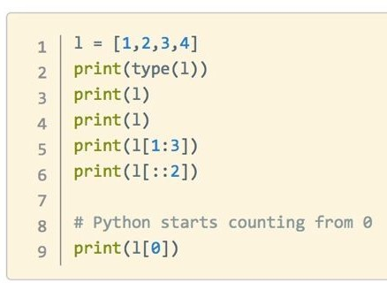
Data Structures
Lists
A collection of objects
Mixed types are okay
Deﬁned with square brackets [ ]
They can be modiﬁed
my_list.append()
my_list.insert()
my_list.remove()
my_list.pop()
List Index
Slicing
Access elements
my_list[ start : end : step ]

Slide 28
Working with Lists
Let's work together with some “Lists”
Create a list of all TeamMates => mates.
Print length of list.
Print 2nd name on list.
Delete 1st name in the list and add to variable name_removed.
Add the name deleted in step 3, to the end of list.
Remove the added name from last location.
Re-add the name at 1st location.
For Loop with Lists
Loop through the list of mates and print “Welcome to the class, <mate name>”
Loop through the list of mates and print names which have ‘a’ in the name
Loop through the list of mates and print first ‘n’ names from the list

Slide 29
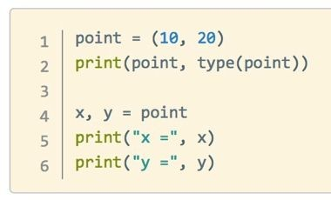
Data Structures
Tuples
very similar to lists, but:
They are deﬁned with parentheses ( ) instead of square brackets
They cannot be changed
No append() method
No remove() method
Slicing works the same way

Slide 30
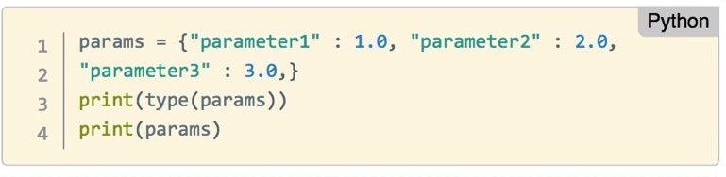
Data Structures
Dictionaries
Collections of key/value pairs
Deﬁned by curly brackets { }
Slicing uses keys
Order is not preserved

Slide 31
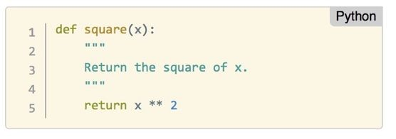
Control Structures
Functions
Groups of instructions repeat / create abstractions of common tasks.
Divide our code into useful blocks
Provide order, making the code more readable and reusable
def name(input1, input2, …) :
First line is “Document String” describing how function works
Deﬁnition saves instructions only - no execution!

Slide 32
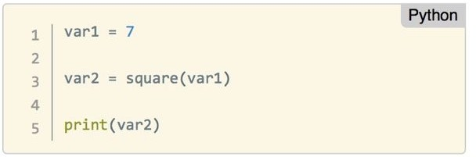
Control Structures
Functions
Run functions with parentheses after the name
Needs to be deﬁned before it can be executed!
The return value is saved in var2
Other functions can be run on the result!

Slide 33
Working with Functions
Let's work together with some “Functions”
Create a function to add 3 numbers.
Create a function to print first ‘n’ odd numbers.
Create a function FIZZBUZZ
# Write a function that prints the numbers from 1 to 101.
# But, for multiples of three, print “Fizz” instead of the number.
# For multiples of five, print “Buzz”.
# For numbers which are multiples of both three and five, print “FizzBuzz”.

Slide 34
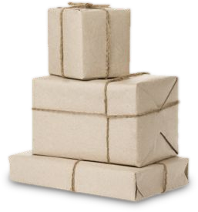
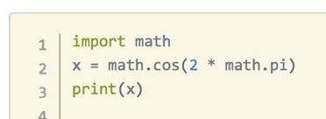
Expanding python
Packages
Install new libraries to add functionality to Python: conda install <name>
or
pip install <name>
Use packages by importing them into your Python scripts

Slide 35
Real Cases: Expanding python
Common Packages
Data manipulation: PANDAS, NUMPY, SCIPY
Machine Learning: SCIKIT-LEARN, NLTK
Databases: PSYCOPQ2, SQLALCHEMY
Visualizations: MATPLOTLIB, PLOTLY, BOKEH
API / web scraping: REQUESTS, BEAUTIFULSOUP
, SCRAPY
Web development: DJANGO, FLASK, TWISTED
, SCAPY
Game Development: PYGAME, PYGLET
Desktop App: PYQT, TKINTER
… … …

Slide 36
Thank You !!!

